Slide 1
Introuction to Malgram
Phillip Porras and Hassen Saidi
Computer Science Laboratory, SRI International Date: 2012-02-16
Copyright SRI International

Slide 3
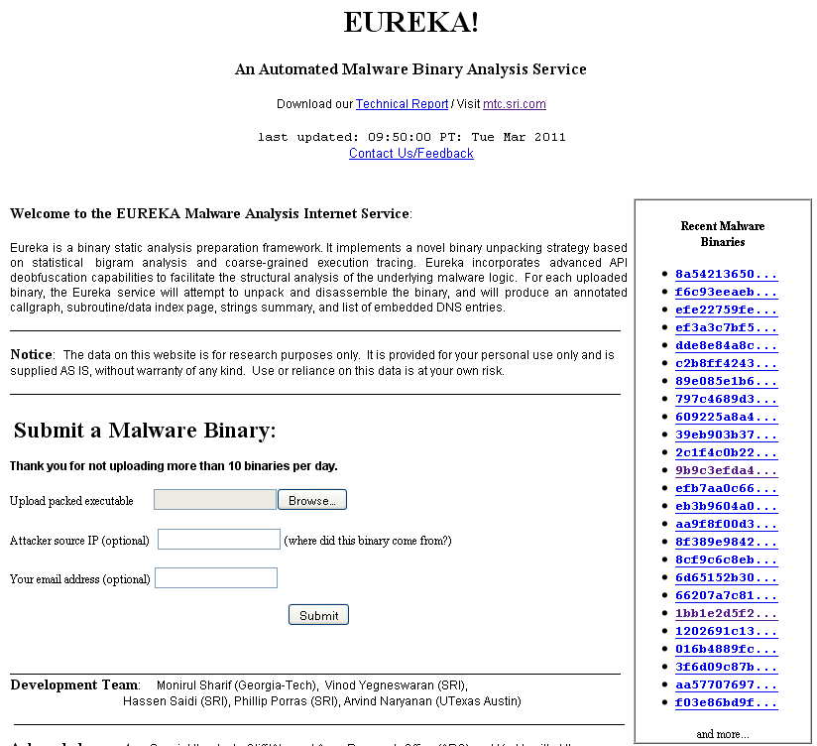
First Generation Binary Analysis
http://eureka.cyber-ta.org
First Online Free Unpacking System
Went Live November 2007

Slide 4
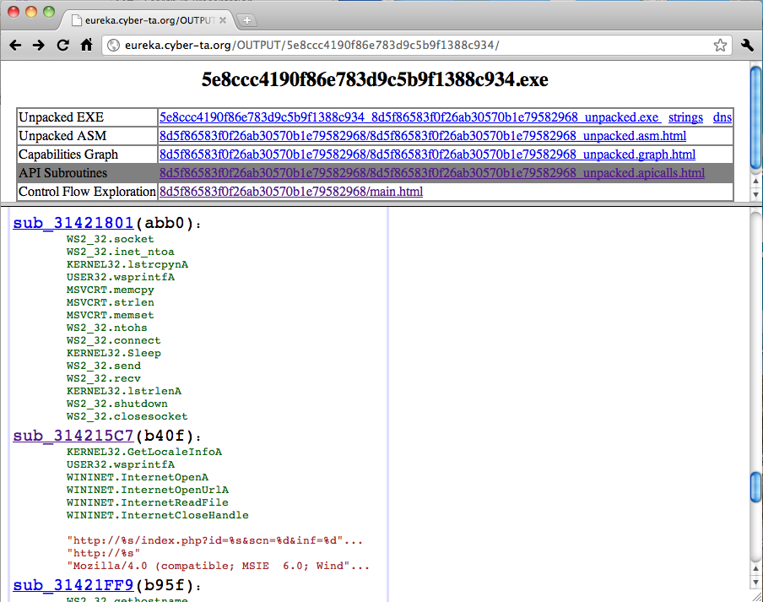
First Generation Binary Analysis

Slide 5
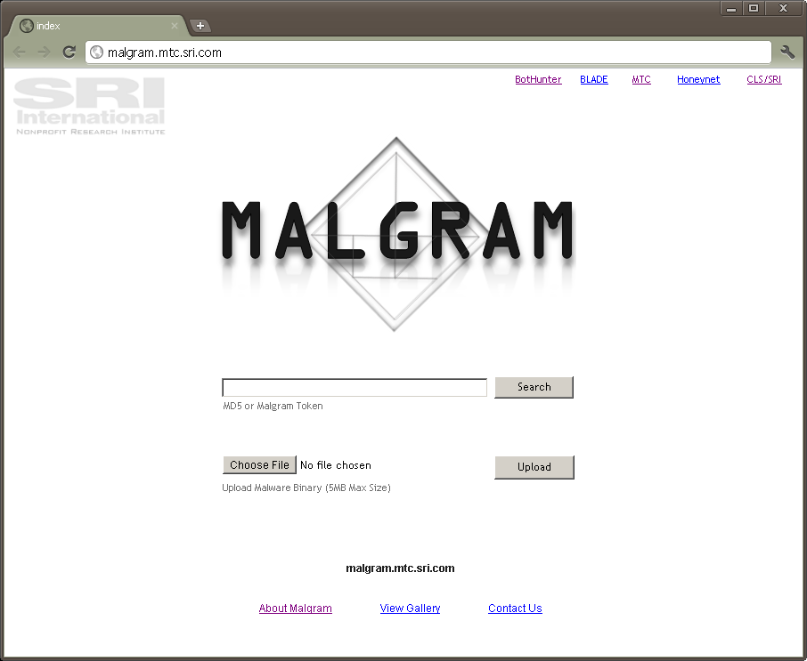
2nd Generation: Full Auto-Reverse Engineering
Apache
Virtualbox
Ubuntu Linux

Slide 6
Binary Structural Analysis
Binary Structure
Virus Analyzer
FastTrack
PEID
Binary Structure
A structural analysis to classify and label the binary sample
Virus Analysis – the binary is vetted against a battery of 54 antivirus tools. Labels are normalized and a diagnosis string is produced from the longest common substring of AV labels
FastTrack – employs an image based processing algorithm to conduct a supervised labeling of unknown binaries to a corpus of labeled binaries
L. Nataraj, V. Yegneswaran, P. Porras, J. Zhang, A Comparative Assessment of Malware Classification Using Binary Texture Analysis and Dynamic Analysis, in the 4TH ACM Workshop on Artificial Intelligence and Security, 2011.
PEID - PEiD detects most common packers, cryptors and compilers for PE files. It can currently detect more than 600 different signatures in PE files
Web
Interface
Apache
Virtualbox
Ubuntu Linux

Slide 7
Dynamic Analyses
Dynamic Analyses
Web
Interface
SRI Sandbox
VM Introspector
Cuckoo Sandbox
Forensics Gen
Dynamic Analyses
involves the execution of an application in a carefully monitored environment to build a profile of the application’s runtime behavior
SRI Sandbox - our proprietary malicious binary execution environment, which employs runtime host and network forensic analyses and post-execution VM image introspection
Cuckoo Sandbox – an open source binary execution sandbox, produced by the Honeynet Project : http://www.cuckoobox.org/
Apache
Virtualbox
Ubuntu Linux

Slide 8
Static Analyses
Static Analysis
A reverse analysis which attempts to produce an approximation of the original source code implementation of an application
Binary Unpacker - SRI’s 2nd-generation Eureka binary unpacking system
C Code Generation – a post processing of the binary disassembly to reverse common obfuscations, isolate the OEP, produce an iterative type analysis
Program Analytics – post processes the C program to extract important program semantics
Web
Interface
C Code Generation
Program Analytics
Binary Unpacking
Call graph
HTML gen
Native API
Tracing
Renaissance
.asm to C
Decompilation
Cryptfinder
IDA Pro
SRI
Deobfuscator libs
Win API Recovery
Eureka II
Assembly
post-processing
String / DNS
analysis
Apache
Virtualbox
Ubuntu Linux

Slide 9
Report Generation
Binary Structure
Virus Analyzer
FastTrack
PEID
HTML/PDF
Report
Generator
Dynamic Analyses
Web
Interface
SRI Sandbox
VM Introspector
Cuckoo Sandbox
Forensics Gen
C Code Generation
Program Analytics
Binary Unpacking
Call graph
HTML gen
Native API
Tracing
Renaissance
.asm to C
Decompilation
Cryptfinder
IDA Pro
SRI
Deobfuscator libs
Win API Recovery
Eureka II
Assembly
post-processing
String / DNS
analysis
Apache
Virtualbox
Ubuntu Linux

Slide 10
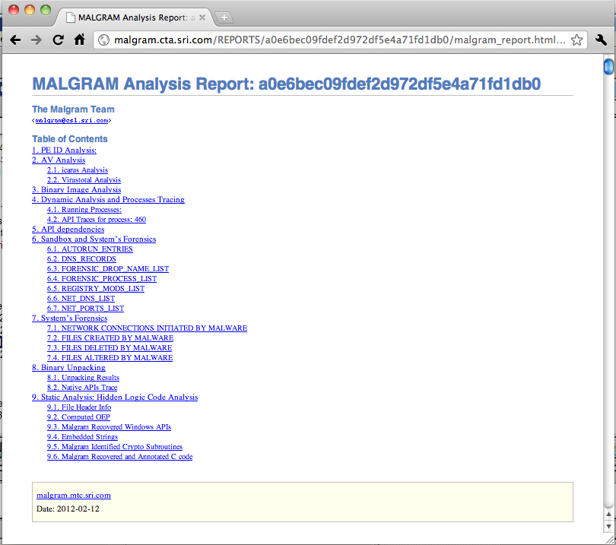

Slide 11
Binary Structural Analysis

Slide 12
Binary Structural Analysis
Virus Analysis –
Malgram employs a private interface to VirusTotal to vet binary MD5s
We normalize all labels to remove extraneous or non-informative substrings
Using the top 7 AV systems, based on +1M binaries assessed, we perform a Longest Common Substring Analysis on the Binary.
We produce a final AV diagnosis string based on the LCS, and record all reported AV labels

Slide 13
Binary Structural Analysis: FastTrack
﻿Binary Texture Analysis was proposed as a method for rapid binary classification
[1] L. Nataraj, S. Karthikeyan, G. Jacob, and B. Manjunath.Malware images: Visualization and automatic classification.
In Proceedings of VizSec, 2011.
A more recent study conducted a large-scale evaluation of this method for supervised classification of malicious packed Win32 Applications:
[2] L. Nataraj, V. Yegneswaran, P.A. Porras, and J. Zhang, "A Comparative Assessment of Malware Classification using Binary
Texture Analysis and Dynamic Analysis," in Proceedings of the ACM CCS Workshop on Artificial Intelligence and Security, October 2011.
Operational Concept: (supervised learning)
Produce a corpus of labeled well-known binaries. convert to 2D greyscale images, where dimensions are based on file size thresholds
Produce a cluster analysis of the corpus
Given a new unknown sample: binary is cast in a 2D grey scale image
Perform knn classification to identify closest matched binaries. If threshold similarity is reached, this new sample is known.

Slide 14
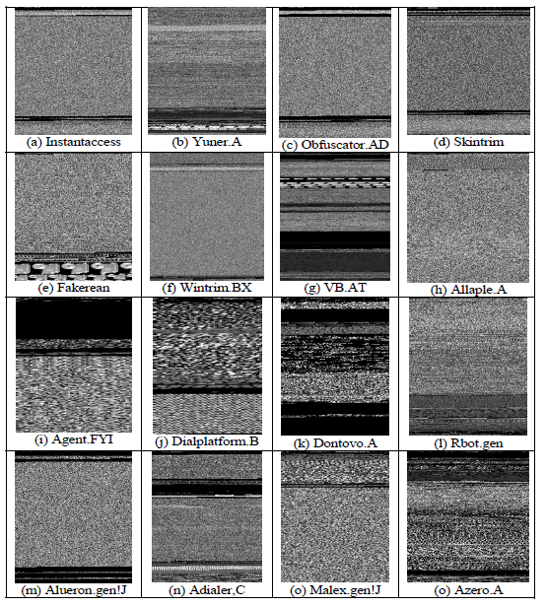
Binary Structural Analysis: FastTrack
﻿
Benefits:
Speed : attribute collection (binary image casting requires on average 40-50ms, vs 30 secs to 3 minutes (1/4000th the processing time).
Resilience : resistant to anti-tracing, anti-reverse engineering, and common code obfuscations
Accuracy : in [2] we showed this analysis was as accurate as current classification schemes based on dynamic analysis.

Slide 15
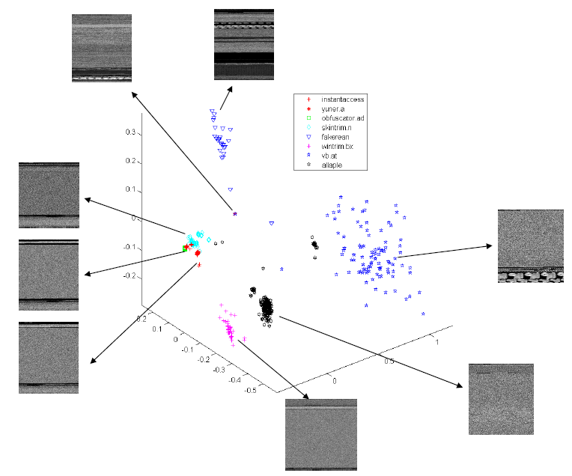
Binary Structural Analysis: FastTrack
Lolyda.AA.PECrypt
Dontovo.AA.UPX

Slide 16
Dynamic Analysis

Slide 17
Dynamic Analysis
Objectives: execution of an application in a carefully monitored environment to build a profile of its runtime behavior
Malgram provides a multi-perspective dynamic analysis
Trace Oriented – API hooking malware at runtime
Live OS Probing – polling and interacting with the system as the malware operates
Intelligent Introspection - conducting a comparative analysis of a VM pre-vs-post infection

Slide 18
Dynamic Analysis: System Tracing
Cuckoo Sandbox – an open source binary execution sandbox, produced by the Honeynet Project : http://www.cuckoobox.org/
(Google 2010 Summer of code project)
﻿Cuckoo employs an API hooking scheme to track key object modifications
It can capture intermediate/transient state modifications (as they occur)
Collection Coverage
Trace of performed relevant win32 API calls
Automatically tracking and tracing spawned processes
Dump of network traffic generated during analysis
Creation of screenshots taken during analysis
Dump of files created, deleted and downloaded by the malware during analysis Trace of assembly instructions executed by malware process

Slide 19
Dynamic Analysis: Live OS Monitoring
SRI Sandbox - - our proprietary malicious binary execution environment, which employs runtime OS probing
Execution Logic:
Launch malware process
After 30sec delay, launch forensics
Forensic probing lasts 3 to 5 minutes
Run dumpit to save full VM State
Power down VM
Comparative Data Collection:
File system alterations
Registry Modifications
Autorun / Service alterations
Packet Traces
Used next to conduct
VM introspection

Slide 20
Dynamic Analysis: Intelligent Introspection
SRI’s Volatility-based Introspection - we remount the VM image using VDFuse and conduct a pre-to-post VM comparison using the Volatility Framework.
Comparative Data Collection:
Process List
Loaded DLLs to Processes
Fine grained File system modifications
System module modifications
Open Network Connections
SSDT Modifications

Slide 21
Dynamic Analyses: Complementary Results
Reverse Engineering Weaknesses | Cuckoo Live System Tracing | SRI Sandbox Live OS Probing | SRI Volatility Processor VM Introspection
API Hook Detection | Vulnerable | Resistant | Resistant
Suicide Testing | More invasive | Less Invasive | Non-Invasive
Transient object mods | Resistant | Vulnerable (Snapshotting) | Vulnerable (Final State Only)
Vbox Shared Folder Detection | Vulnerable | Resistant (uses SAMBA) | Resistant
Rootkit object hiding | Sees RK Setup (otherwise vuln) | Vulnerable | Resistant (not subject)
Resource Locking | Partially Vulnerable | Vulnerable | Resistant
Malware Stability | Invasive (may crash malware) | Non-Invasive | Non-Invasive

